Slide 1




Mathematical Morphology for plant sciences
David Legland, Sylvain Prigent,
Ignacio Arganda-Carreras, Philippe Andrey
Microscopie Fonctionnelle en Biologie
Du 30/09 au 07/10, Seignosse

Slide 2
Before we start...
Does everybody know ImageJ/Fiji ?
Does everybody uses ImageJ/Fiji ?
Does everybody develop with ImageJ/Fiji ?
Macros ?
Plugins ?
[Does everybody have ImageJ/Fiji on LapTop ?]

Slide 3

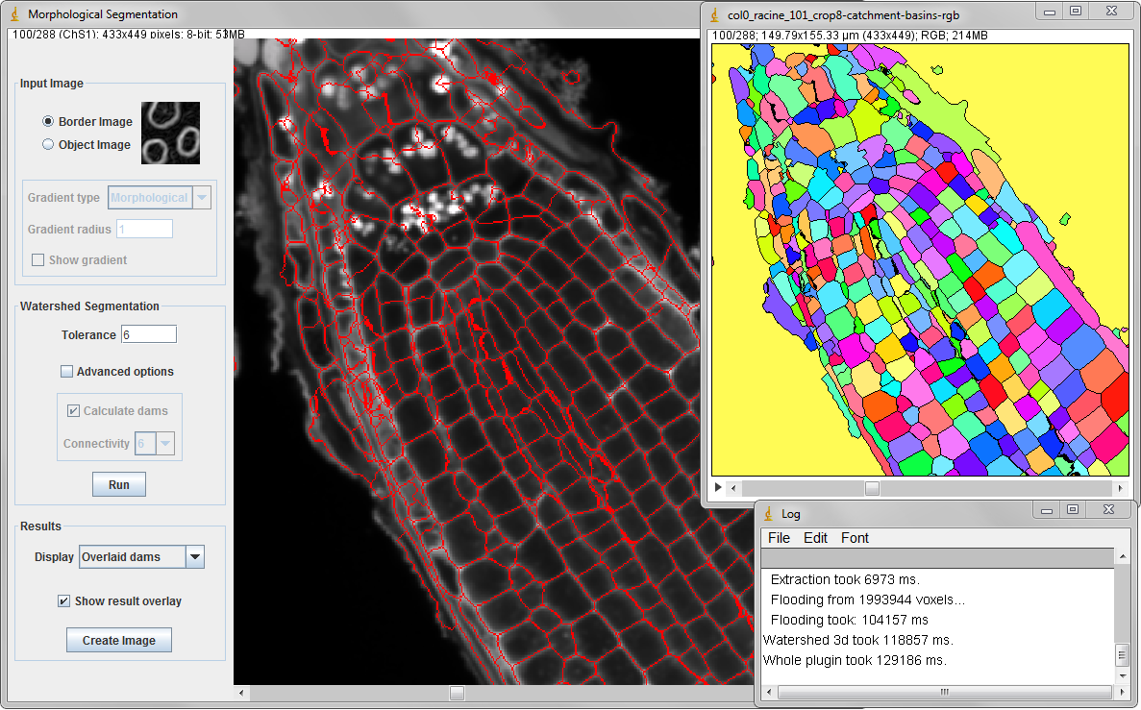
Mathematical Morphology?
Set-theoretic approach for image analysis
Extensions
Grayscale images
2D, 3D... ND images
Skeleton, Watershed...
References
Serra (1982)
Soille (2003)
ImageJ / Fiji
Widely used by (plant) biologists
Few or limited existing MM plugins
=> MorphoLibJ

Slide 4

The MorphoLibJ library
ImageJ plugin
Developed at IJPB
Provides implementation of many MM algorithms, with GUI
Main page:
http://imagej.net/MorphoLibJ
Source code:
http://github.com/ijpb/MorphoLibJ/

Slide 5
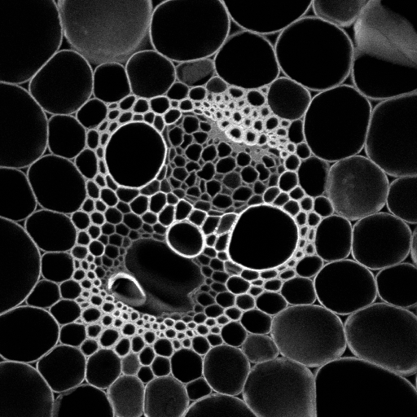
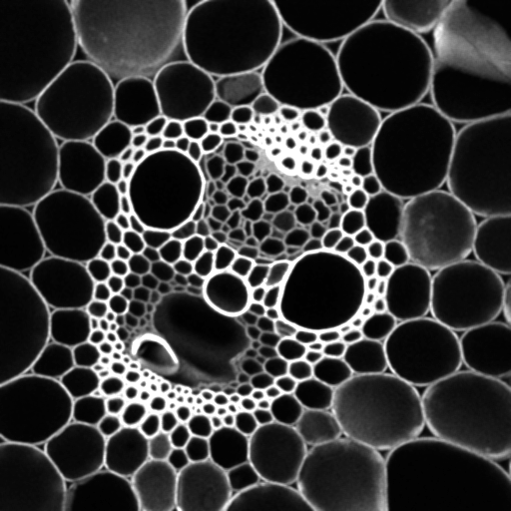
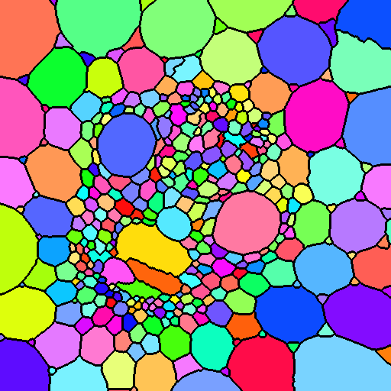
Typical Image processing workflow
Filtering & enhancement
Segmentation
Analysis
Morphological filtering
Morphological reconstruction
Watershed
Particle analysis
Texture analysis
nom | Aire | Diamètre
1 | 106338.3 | 361.098
2 | 70218.3 | 295.065
3 | 75126.2 | 305.979
4 | 122860.9 | 391.435
5 | 75484.3 | 306.734
6 | 65021.3 | 283.923
7 | 98862.4 | 348.279
8 | 69997.7 | 294.174
9 | 72672.9 | 298.124
Original image
Filtered image
Segmented image
Results table

Slide 6
Outline
Filtering and enhancement
Dilate/erode, open/close
Gradients, top hats
Morphological reconstruction
Principle
Applications
Segmentation
Watershed segmentation
Minima selection
Post-processing
Analysis
Geometric measures
Stereology
Gray level granulometry
Geodesic

Slide 7
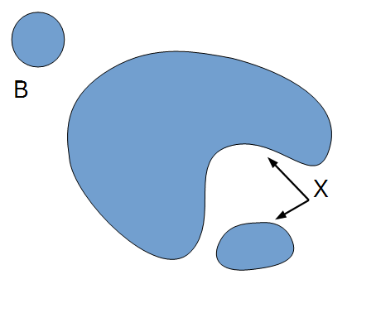
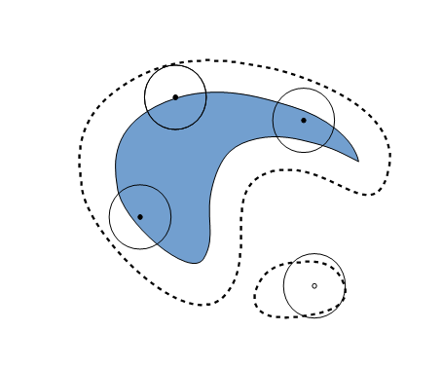
Morphological filters Binary erosion
Set-theoretic operation
Defined by a structuring element (SE)
Does the structuring element fit the set ?

Slide 8
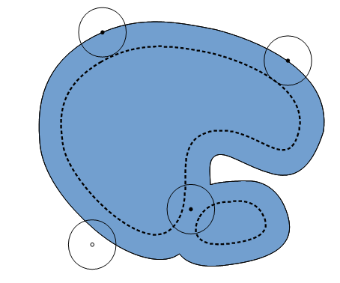
Morphological filters Binary dilation
Set-theoretic operation
Defined by a structuring element (SE)
Does the SE hit the set ?

Slide 9
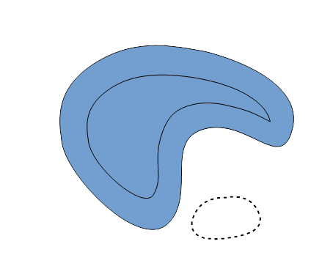
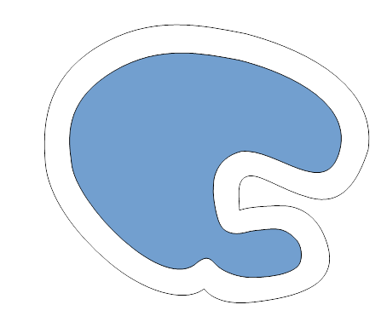
Morphological filters Binary opening and closing
Opening:
Erosion followed by dilation
Remove small objects
Separate components
Closing:
Dilation followed by erosion
Remove small holes
Merge components

Slide 10
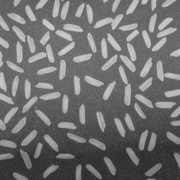
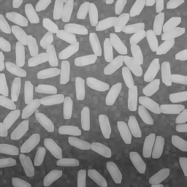
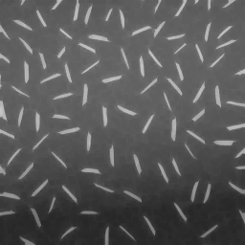
Grey scale morphological filters dilation & erosion
Original image
Dilation result
Erosion result
Dilation: compute maximum value in neighbourhood
Erosion: compute minimum value in neighbourhood

Slide 11
Grey scale morphological filters closing & opening
Original image
Closing result
Opening result
Cl = Ero ( Dil (I) )
Removes small dark structures
Op = Dil ( Ero (I) )
Removes small bright structures

Slide 12
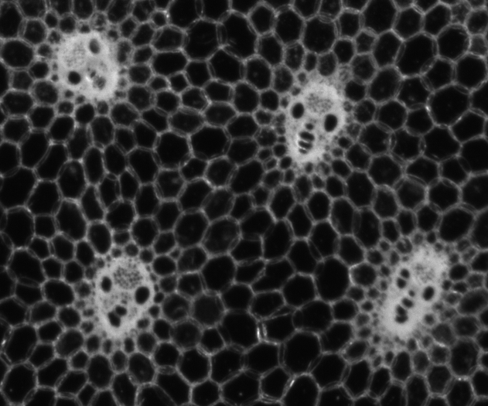
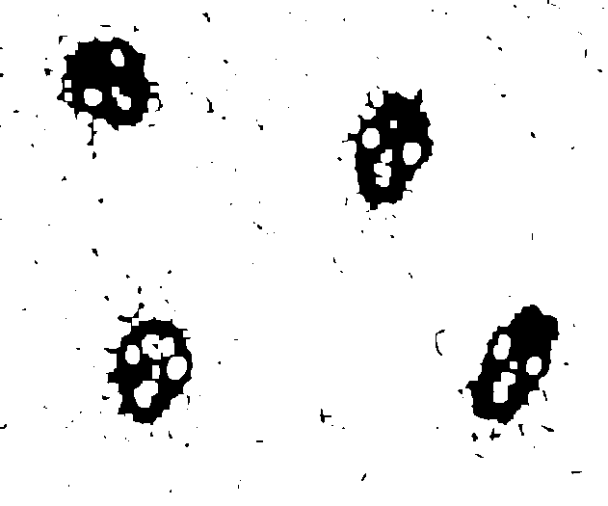

Closing and opening for post-processing of segmentation
image
Raw segmentation
Closing -> removes holes
Opening-> removes “dirts”

Slide 13
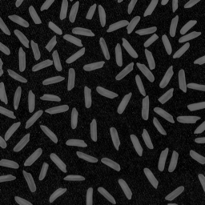
Grey scale morphological filters top-hats (1)
Original image
Opening result
(large SE...)
White Top-hat result
WTH(I) = I – Opening (I)
Enhances small bright structures
BTH(I) = Closing (I) - I
Enhances small dark structures

Slide 14
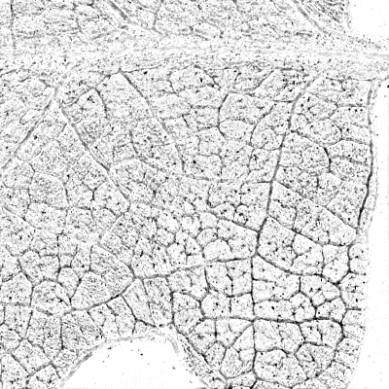
Grey scale morphological filters top-hats (2)
Détection de structures fines / spots
White TopHat
Seuillage + superposition

Slide 15
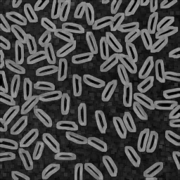
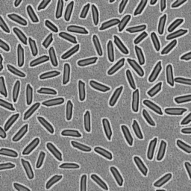
Grey scale morphological filters gradient(s)
Dilation result
Erosion result
Morphological gradient
Grad (I) = Dil (I) – Ero (I)
Identifies contours
No interpolation artifact
Lap (I) = Dil (I) + Ero (I) – 2 * I

Slide 16
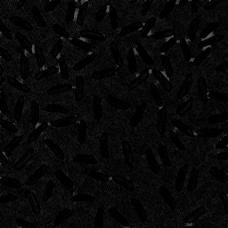
Morphological filters relationships
White
Top Hat
Dilation
Closing
Gradient
Laplacian
Erosion
Opening
Black
Top Hat

Slide 17
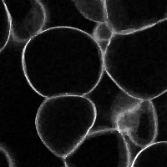
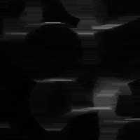
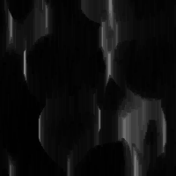
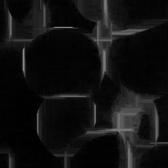
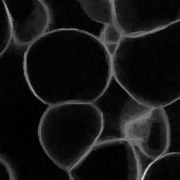
Grey scale morphological filters oriented filtering
Original image
Horizontal opening
Vertical opening
Allows for enhancing
linear structures

Slide 18
Morphological filters summary

Slide 19
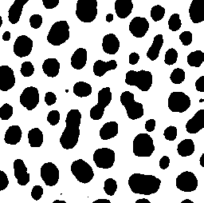
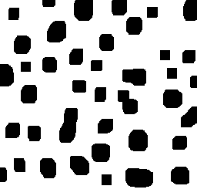
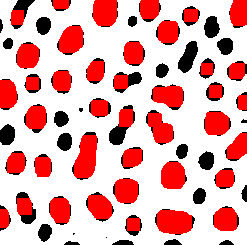
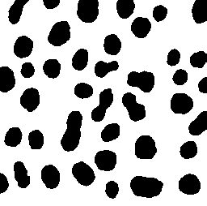
Morphological reconstruction introduction
Problem: (basic) morphological filters tend to modify shape of structures
Idea: keep the original shape of selected regions
original
Morphological opening
removes small items
Shape of remaining
items changes...
What we want

Slide 20
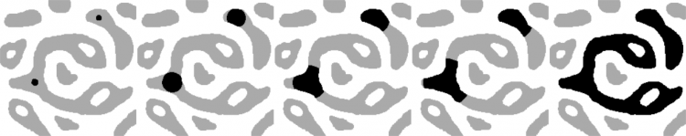
Morphological reconstruction introduction
Principle:
Dilate marker image
Constrain dilation to mask image
Repeat until idempotence
Used in many algorithms

Slide 21
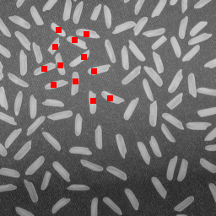
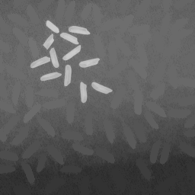
Morphological reconstruction grey level images
Image + marker
Result of morphological reconstruction

Slide 22
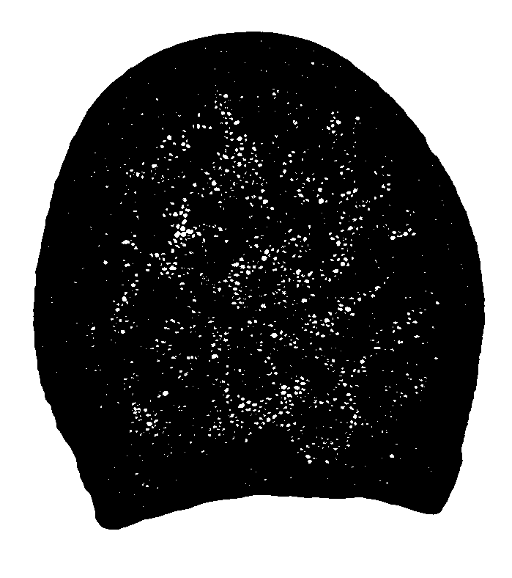
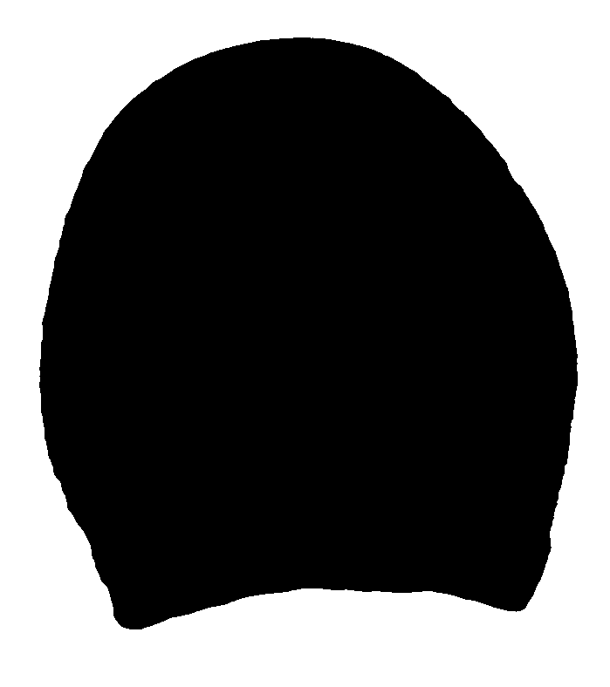
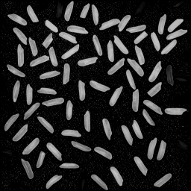
Morphological reconstruction application examples
Kill borders
Fill Holes

Slide 23
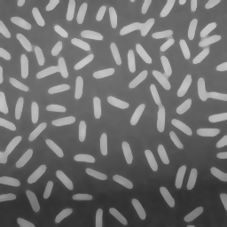
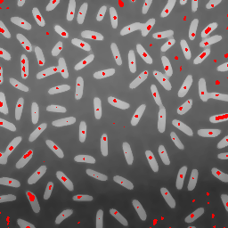
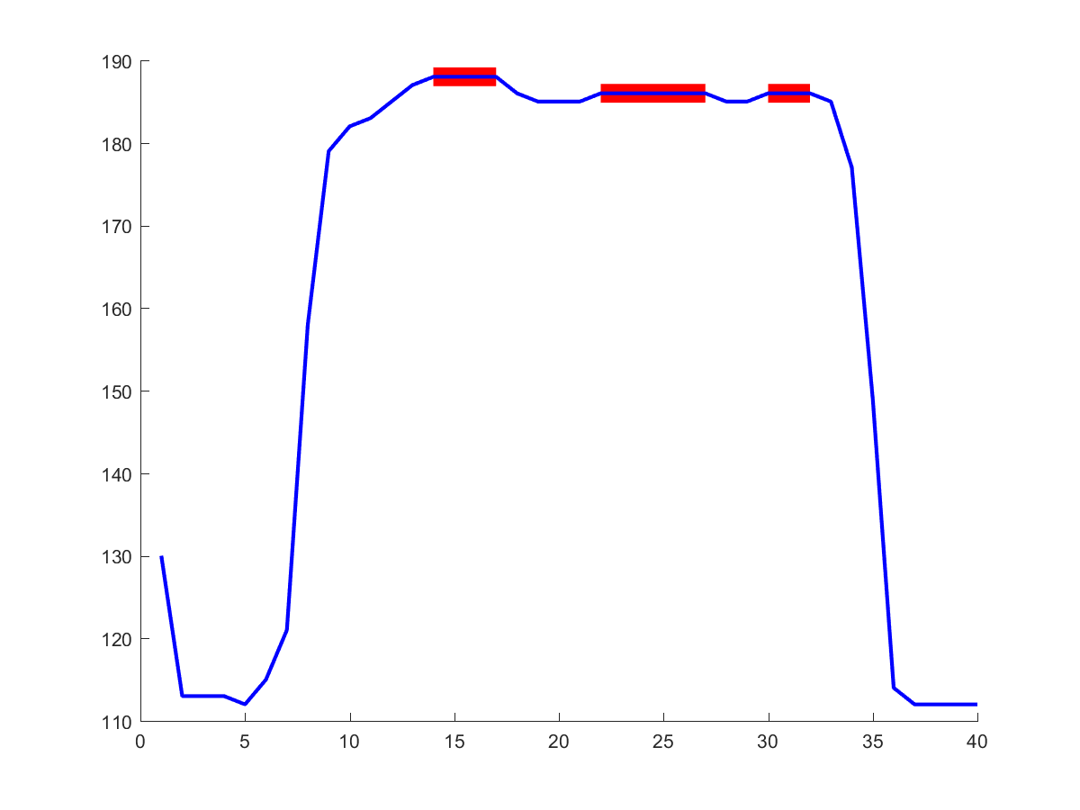
Regional and extended extrema
Regional Maximum:
Set of connected pixels / voxels
With the same value
Such that all region neighbours have lower value

Slide 24
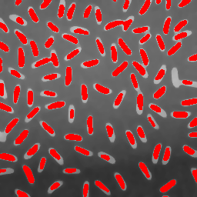
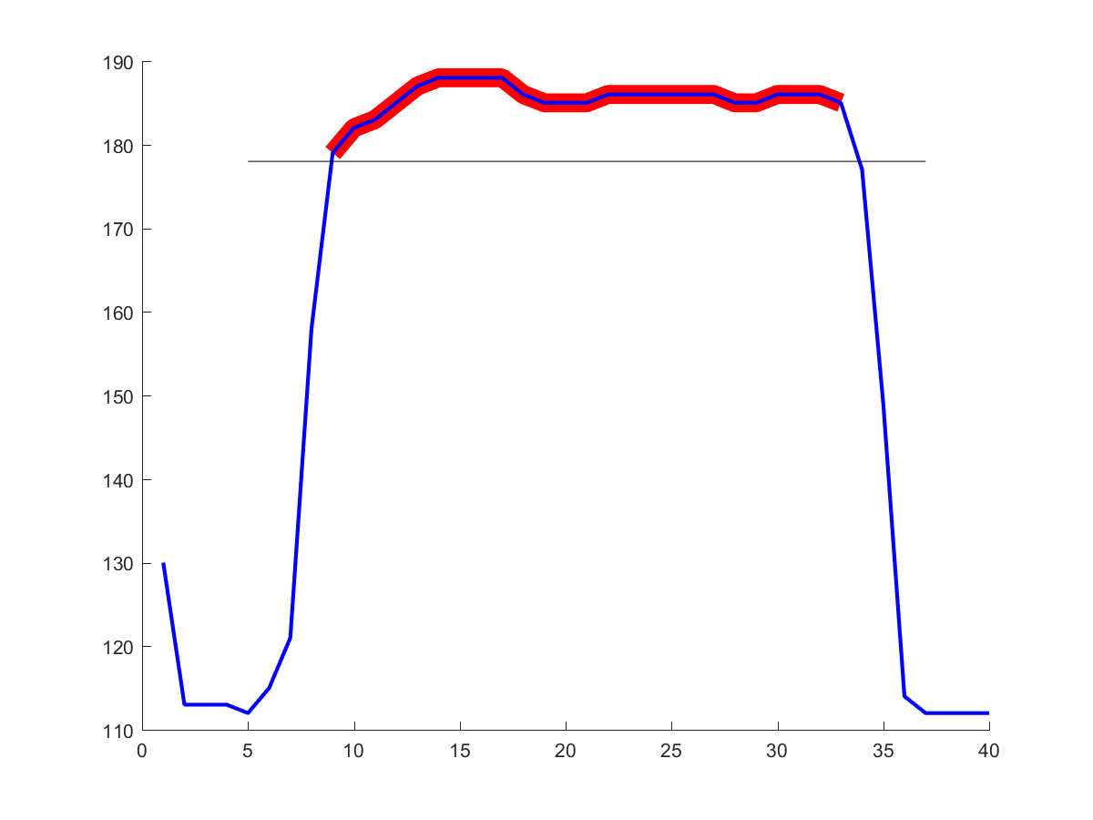
Regional and extended extrema
Extended Maximum: use a tolerance “H”...
Set of connected pixels / voxels
With difference of values < H
Such that all region neighbours have lower values (below max_R(I)-H)

Slide 25
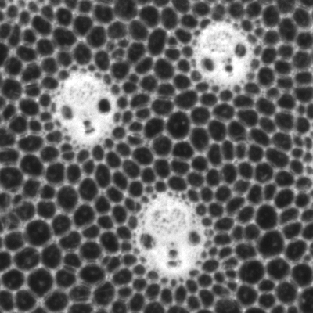
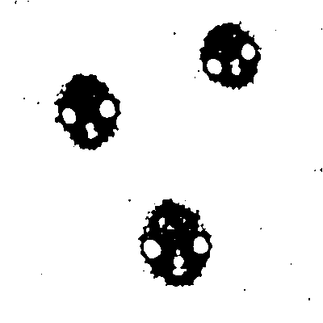
Segmentation
Objective:
identify the structure(s) of interest in the input image
Output:
Label image
Position(s), geometrical models
Example: threshold

Slide 26

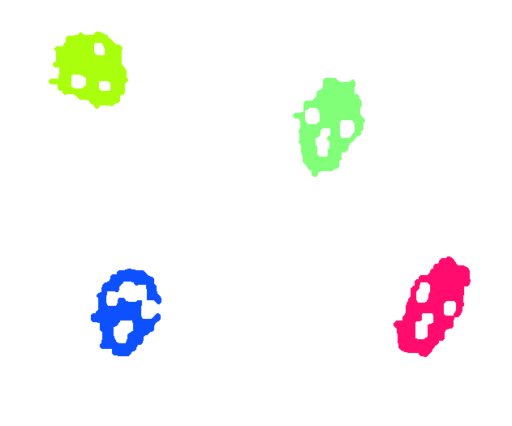
Connected components labelling
Transform a binary image into a label image
Label ⬄ particle ID
Several algorithms:
Raster scan + labels merge
Flood-fill
Breadth-first
Depth first
Line based
...
Need to specify connectivity
Notes:
TODO : remplacer par une image avec plein de cellules

Slide 27
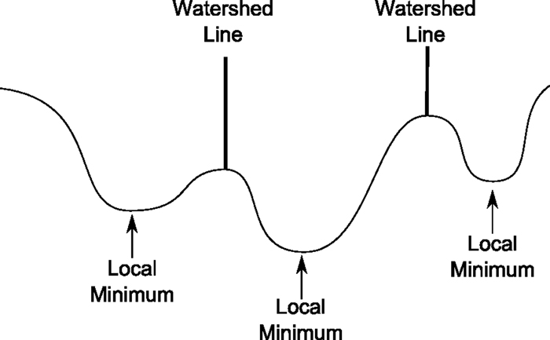
Watershed-based segmentation
Use a topographic analogy
Principle:
Consider grey levels as altitudes
Identify local minima
Flood basins starting from minima
Separate the basins by a “dam” -> the watershed

Slide 28
Watershed limitations
Over-segmentation (too many regions)
due to the presence of many local minima

Slide 29
Example of watershed
Install MorphoLibJ library
Launch ImageJ / Fiji
Read image file
“appleCells-smooth.tif”
Or smaller one
eventually smooth or filter
Segmentation operators in:
MorphoLibJ -> Segmentation
Run “Classic Watershed”

Slide 30
Example of watershed
Options:
No mask
Uncheck diagonal conn.
Use default hmin & hmax
Process
[Change colormap]
To see the minima:
MorphoLibJ -> Minima and Maxima -> Regional Min & Max

Slide 31
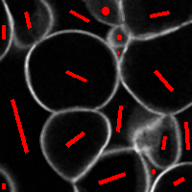
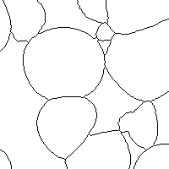
Watershed with markers
Manually impose the minima over image

Slide 32
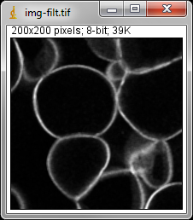
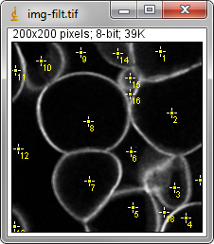
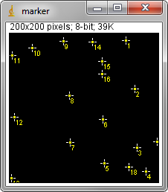
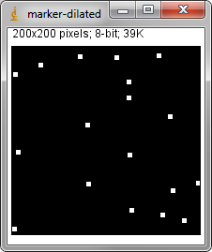
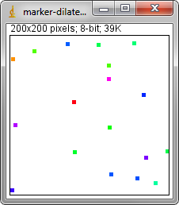

Watershed with markers
Procedure
Use point selection
Click, click, click...
Create a new image
Same size as original
Fill with black
Copy selection (ctrl+shift+E)
Draw selection (ctrl+D)
[dilate]
Marker-controlled Watershed
Without mask, with dams
No diagonal connectivity
Alternative
Use minima imposition

Slide 33


Watershed
Idea: remove unwanted minima
Filtering of input image (gaussian, median...)
Automatically detect minima
Use extended minima

Slide 34

Implemented with GUI
Plugins -> MorphoLibJ -> Segmentation -> Morphological Segmentation

Slide 35


More on watershed : segmentation of contrasted object
Idea: apply watershed on gradient of image
Gradient can be of any type (linear, morphological)...

Slide 36
More on watershed: separation of binary particles
Input image
Touching nuclei
Separated nuclei
Distance map
WS on reversed DM
WS lines

Slide 37

3D watershed
Works exactly the same!

Slide 38

Morphological segmentation summary
Watershed algorithm
Segment cells
Segment objects
Separate particles
Connected components filters useful for post-processing operations and / or labeling

Slide 39

Post-processing
Label edition plugin
Kill borders – choose borders

Slide 40
Image analysis

Slide 41
La question
Why do we acquire images?
Illustration, exploration
Observation & visual comparison
Quantitative analysis of images
Données
(Images)
Connaissances,
résultats
?

Slide 42



Iamgea analysis
Objective: extract quantitative features
Analyse
nom | Aire | Diamètre
1 | 106338.3 | 361.098
2 | 70218.3 | 295.065
3 | 75126.2 | 305.979
4 | 122860.9 | 391.435
5 | 75484.3 | 306.734
6 | 65021.3 | 283.923
7 | 98862.4 | 348.279
8 | 69997.7 | 294.174
9 | 72672.9 | 298.124
Compter
les objets
Mesurer les
intensités
Mesurer leurs
dimensions
Déterminer
leur organisation
Image
Caractériser
leurs formes
Quantifier les textures
Mesures
1
4
5
2
3
6
7

Slide 43


Quantitative analysis of plant tissues
Microscopic scale
3D images
Macroscopic scale
Identify individual cells
With low SNR
Quantify size / shape
Quantify spatial organization
Identify 3D cells
With lower SNR
Quantify size / shape
Texture analysis

Slide 44


Region analysis
Morphometry 2D
Area
Perimeter
Euler Number
Morphometry 3D
Volume
Surface area
Euler Number
Additivity property
Stereological relationships
A_{A}=V_{V}, B_{A}=S_{V}

Slide 45




Validation of measurements
Two criteria:
Accuracy (bias)
Precision (variability)
Estimate perimeter/surface
with Crofton formula:
Error may not decrease with resolution!
Lehmann and Legland, 2010

Slide 46



Geodesic diameter
Path
Curve C contained in X
Geodesic path
Curve with shortest length
dg = min length(C)
Geodesic diameter
Maximum of geodesic lengths
Dg = max dg(x,y)
Lantuéjoul & Beucher, 1981

Slide 47

Shape analysis
Geodesic elongation
Dg / Th
Geodesic shape factor
(π / 4) * Dg² / A
Tortuosity
Dg / Fmax
Thickness
Fmax

Slide 48








Application: classification of hemp fibres based on morphological features
Fibre samples

Slide 49

Topology analysis: region adjacency graph (RAG)
Objectives:
Provide information about cell network topology
Help the classification of regions/cells by also considering the neighbors features
Original image
Segmentation
Region Adjacency Graph

Slide 50

Morphological granulometry
Image texture analysis
Application of image filters with increasing sizes

Slide 51




Mathematical morphology: granulometric curves
Variation of sum
of grey levels (%)
350 µm
10.7 mm
450 µm
Size of structuring element (µm)

Slide 52

Granulometric curve depending on distance to epidermis
Cell mean grey size

Slide 53
End
Main references
Legland D, Arganda-Carreras I, Andrey P (2016). MorphoLibJ: integrated library and plugins for mathematical morphology with ImageJ. Bioinformatics, doi:10.1093/bioinformatics/btw413
Soille, P (2003). Morphological Image Analysis. Springer, Second edition
Serra, J. (1982). Image Analysis and Mathematical Morphology. Volume 1, Academic Press
Analysis
Legland D., Kiêu K. and Devaux M.-F. (2007). Computation of Minkowski measures on 2D and 3D binary images. Image Anal. Stereol., 26, 83-92
Ohser J. and Mücklich F. (2000) ‘Statistical Analysis of Microstructures in Materials Sciences’. J. Wiley & Sons
Lehmann, G. & Legland, D. (2009). Efficient N-Dimensional surface estimation using Crofton formula and run-length encoding. The Insight Journal
Applications
Legland, D. & Beaugrand, J. (2013) Automated clustering of lignocellulosic fibres based on morphometric features and using clustering of variables. Industrial Crops and Products, 45, 253 – 261
Devaux, M.-F., Bouchet, B., Legland, D., Guillon, F. & Lahaye, M. (2008). Macro-vision and grey level granulometry for quantification of tomato pericarp structure. Postharvest Biol. Technol., 47, 199-209
Silva JVC, Legland D, Cauty C, Kolotuev I, Floury J. (2015). Characterization of the microstructure of dairy systems using automated image analysis. Food Hydrocolloids, 44, 360 - 371

Slide 54









Combining directional filtering + attribute filtering + watershed
Original
Directional filtering
Dir. Filt. - AWTH
Attribute White Top Hat

Slide 55

Morphological reconstruction area opening

Slide 56


Geodesic measurements
Geodesic distance map
Geodesic diameter
(Implementation based on chamfer distances)

